Slide 1


YOUNG IFSO SESSION
WILL LAPAROSCOPIC MBS
REMAIN THE FUTURE?
A global view beyond elective surgery
Angelo Iossa, Md Phd
Head of Bariatric Center of Excellence SICOB
ICOT Hospital Latina
Sapienza University of Rome
Friday 18 September | 16:00–16:10
Sala Milano · Building 2 · Pala Todisco, Pisa
SCALPEL, SCOPE, OR SYRINGE?
Notes:
[SPEAKER SCRIPT]
Good afternoon. The title asks whether laparoscopic MBS will remain the future. I will answer from a global perspective, focusing on access, emergencies and the skills that must survive as technology changes.
[TRANSITION | 30 seconds]
Define the tests used to judge a durable surgical platform.
[SOURCES]
XXXIV SICOB National Congress official programme: https://globalia.cloud/sicobpisa2026/programma_sinottico.aspx
Young IFSO official page: https://www.ifso.com/young-ifso/

Slide 2
THE QUESTION BEHIND THE TITLE
Three tests for a durable surgical platform
01
02
03
REACH
RESCUE
TRANSFER
Can most health systems sustain it?
Is it available when the patient cannot wait?
Does it preserve skills across platforms?
The future is determined by deployment, availability and competence.
SICOB PISA 2026
YOUNG IFSO SESSION
02
Notes:
[SPEAKER SCRIPT]
A platform remains relevant when it passes three tests. Reach means that health systems can deploy it. Rescue means that surgeons can mobilise it when the patient cannot wait. Transfer means that its competencies remain useful when the preferred platform fails or is unavailable.
[TRANSITION | 35 seconds]
Before applying these tests, remember what laparoscopy did to the scale of MBS.

Slide 3
THE FIRST PLATFORM SHIFT
Laparoscopy enabled MBS to scale worldwide
4.8×
increase from 2003
to the 2018 peak
95.7%
performed laparoscopically
in 2013
2021: 604,099 procedures reported after the pandemic decline.
Worldwide survey totals are estimates from different reporting cycles, not a continuous registry.
SICOB PISA 2026
YOUNG IFSO SESSION
03
Notes:
[SPEAKER SCRIPT]
The first major platform shift transformed our field. Reported worldwide procedures increased from about 146,000 in 2003 to a peak of almost 700,000 in 2018. More than 90 percent were already laparoscopic in 2008, and the proportion reached 95.7 percent in 2013. Activity fell during the pandemic and recovered to about 604,000 reported procedures in 2021. Laparoscopy reduced operative access trauma and made established procedures reproducible across centres, creating the conditions for MBS to expand globally.
[TRANSITION | 50 seconds]
The longer timeline is compelling, but the most recent survey also shows the limits of global measurement.
[SOURCES]
Buchwald H, Williams SE. Obes Surg. 2004;14:1157–1164.
Buchwald H, Oien DM. Obes Surg. 2009;19:1605–1611. PMID: 19885707.
Angrisani L et al. Obes Surg. 2015;25:1822–1832. PMID: 25835983.
Angrisani L et al. Obes Surg. 2018;28:3139–3149. PMID: 30121858.
Angrisani L et al. Obes Surg. 2021;31:223–235. Bariatric Surgery Survey 2018.
Angrisani L et al. Obes Surg. 2024;34:1075–1085. PMID: 38438667.

Slide 4
LIMITS OF THE LATEST IFSO SURVEY
The global platform mix remains incompletely measured
57 / 74
42.1%
NO
national societies responded
used national registry data
harmonised global denominator
for laparoscopic versus robotic MBS
Reported volume does not equal global treatment need, and national adoption curves cannot define one worldwide platform share.
The 2020–2021 survey is the latest published worldwide procedural survey.
IFSO Table 1 reports 604,099 surgical and endoluminal procedures for 2021.
SICOB PISA 2026
YOUNG IFSO SESSION
04
Notes:
[SPEAKER SCRIPT]
The 2020–2021 IFSO survey is the latest published worldwide procedural survey. Its detailed table reports 604,099 surgical and endoluminal procedures in 2021. However, only 57 of 74 national societies responded, and 42.1 percent used national registries. Most importantly for this talk, the survey does not provide a harmonised worldwide denominator separating laparoscopic from robotic MBS. We can describe reported volume and geography, but we cannot claim one precise global platform percentage.
[TRANSITION | 45 seconds]
We can still examine where the reported activity occurred.
[SOURCES]
Angrisani L et al. Obes Surg. 2024;34:1075–1085. PMID: 38438667.

Slide 5
DISTRIBUTION BY IFSO CHAPTER
North America and Europe reported 61% of 2021 activity
30.9%
North America
30.4%
Europe
Chapter totals from IFSO Worldwide Survey Tables 2–6. Reported activity is not treatment need.
SICOB PISA 2026
YOUNG IFSO SESSION
05
Notes:
[SPEAKER SCRIPT]
North America and Europe each accounted for about 30 percent of reported activity. Latin America accounted for 17 percent, Asia-Pacific for 13 percent and the Middle East and North Africa for 9 percent. This is reported activity, not prevalence or treatment need. It also shows why trends from a single high-income registry cannot define the global future.
[TRANSITION | 45 seconds]
Now consider what this global activity actually consists of.
[SOURCES]
Angrisani L et al. Obes Surg. 2024;34:1075–1085. PMID: 38438667.

Slide 6
2021 SURGICAL MIX
One platform supports the contemporary procedure spectrum
60.3%
Sleeve gastrectomy
27.3%
RYGB
7.9%
OAGB
583,566 surgical procedures
Percentages calculated from IFSO Worldwide Survey Table 1.
SICOB PISA 2026
YOUNG IFSO SESSION
06
Notes:
[SPEAKER SCRIPT]
Sleeve gastrectomy represented 60.3 percent of surgical procedures, RYGB 27.3 percent and OAGB 7.9 percent. Laparoscopy is not tied to one operation. It supports almost the entire established primary and revisional spectrum. That breadth is one reason it behaves like infrastructure rather than a temporary device generation.
[TRANSITION | 45 seconds]
Breadth alone is insufficient. The platform must also be deployable across health systems.
[SOURCES]
Angrisani L et al. Obes Surg. 2024;34:1075–1085. PMID: 38438667.

Slide 7
WHY REPLACEMENT WILL BE UNEVEN
Laparoscopy remains the global backbone
01
INSTALLED BASE
Towers, instruments and teams already serve multiple surgical specialties.
02
TRANSFERABLE SKILL
Access, exposure and rescue principles travel between hospitals.
03
PROCEDURE BREADTH
Primary, revisional and emergency operations remain feasible.
04
CAPITAL BARRIER
New platforms require purchase, maintenance, training and case volume.
A global standard can lose market share and remain indispensable.
SICOB PISA 2026
YOUNG IFSO SESSION
07
Notes:
[SPEAKER SCRIPT]
Laparoscopy already exists across surgical services, and its skills travel between hospitals. It supports primary, revisional and emergency procedures. Robotic systems can add capability, especially in complex surgery, but capital cost, maintenance, trained staff and adequate case volume will make adoption uneven.
[TRANSITION | 45 seconds]
A concrete example shows how different the starting points remain.

Slide 8
RESOURCE-CONSTRAINED SETTINGS
Technology arrives on different timelines
NIGERIA · 2023
The recurring barriers
214
reported bariatric procedures
Equipment
purchase, repair and consumables
Training
dependence on external trainers
Teams
limited locally trained theatre staff
A later laparoscopic transition usually predicts a later robotic transition.
Nigeria is a specific example, not a proxy for a continent.
SICOB PISA 2026
YOUNG IFSO SESSION
08
Notes:
[SPEAKER SCRIPT]
Nigeria illustrates the scale of the access gap. A 2024 review reported 214 bariatric procedures in 2023, including only 75 primary operations. Across low- and middle-income settings, recurring barriers include equipment cost, repair, consumables and dependence on external training. A health system still building laparoscopic capacity will not follow the same robotic adoption curve as the United States.
[TRANSITION | 55 seconds]
The second test is rescue. Platform availability becomes critical during emergencies.
[SOURCES]
Onukak EE et al. Niger J Clin Pract. 2024. PMID: 39219342.
Rosenbaum AJ et al. First experience in laparoscopic surgery in low and middle income countries: a systematic review. 2024. PMID: 38463379.

Slide 9
BARIATRIC EMERGENCIES
At 2 a.m., availability becomes an outcome
ACUTE ABDOMEN AFTER MBS
OBA GUIDELINES
Internal hernia or obstruction
Persistent symptoms with inconclusive clinical and radiological findings
Perforation or leak
Bleeding
LAPAROSCOPIC EXPLORATION
Ischaemia or volvulus
within 12–24 hours when expertise is available
Unfamiliar postoperative anatomy
Elective replacement does not eliminate the need for an emergency platform.
OBA guidelines developed by WSES with IFSO bariatric surgeons.
SICOB PISA 2026
YOUNG IFSO SESSION
09
Notes:
[SPEAKER SCRIPT]
Bariatric emergencies often present years later and in hospitals different from the index centre. The OBA guidelines recommend laparoscopic exploration within 12 to 24 hours when symptoms persist despite inconclusive findings and expertise is available. A platform that cannot be mobilised at night cannot replace the emergency skill set.
[TRANSITION | 55 seconds]
The same logic applies to training: the preferred platform may become unavailable.
[SOURCES]
Di Saverio S et al. World J Emerg Surg. 2022. PMID: 36167572.

Slide 10
TRAINING FOR PLATFORM FAILURE
A robotic future still requires laparoscopic competence
ACCESS
ORIENTATION
CONSOLE
RESCUE
1
2
3
4
Safe entry and pneumoperitoneum
Anatomy, exposure and tissue handling
Platform-specific dexterity
Undocking and laparoscopic conversion
Training should verify laparoscopic access, anatomy and rescue skills without demanding that every trainee first becomes a laparoscopic expert.
SICOB PISA 2026
YOUNG IFSO SESSION
10
Notes:
[SPEAKER SCRIPT]
The argument should remain competency based. Robotic training does not require that every trainee first becomes a laparoscopic expert. It should, however, verify safe abdominal access, creation of pneumoperitoneum, anatomical orientation, emergency undocking and laparoscopic conversion. The interface changes. Responsibility for access and rescue does not.
[TRANSITION | 55 seconds]
Only now introduce the observed robotic growth curve.

Slide 11
UNITED STATES MBSAQIP
Robotic use is rising where infrastructure already exists
2.5×
increase in share
678,357
primary SG and RYGB cases
A US trend cannot define a global replacement date.
Robotic utilization rose from 10% to 25% between 2018 and 2021.
SICOB PISA 2026
YOUNG IFSO SESSION
11
Notes:
[SPEAKER SCRIPT]
In a large MBSAQIP analysis, robotic utilization for primary sleeve and RYGB rose from 10 percent in 2018 to 25 percent in 2021. This is a real and rapid change. It describes accredited US centres, not the world. The global future will combine different adoption curves rather than follow a single replacement date.
[TRANSITION | 45 seconds]
Use the observed US growth as one input to a transparent 2035 scenario.
[SOURCES]
Robotic-Assisted Bariatric Surgery Compared to Standard Laparoscopy: Utilization Trends, Outcomes, and Operative Times. Obes Surg. 2026. PMID: 41107659.

Slide 12
SCENARIO INFORMED BY UNEQUAL ADOPTION
2035: a plausible distribution, not a prediction
Illustrative global mix
ASSUMPTIONS
Continued US growth
Slower diffusion outside high-resource systems
Persistent emergency and fallback use
Expanding MBS
Mature lap systems
High-tech systems
72%
illustrative global
laparoscopic share
Scenario values are explicit assumptions, not observed data or an established forecast.
SICOB PISA 2026
YOUNG IFSO SESSION
12
Notes:
[SPEAKER SCRIPT]
This scenario is deliberately transparent. It assumes strong robotic growth in high-technology systems, slower diffusion elsewhere and persistent laparoscopic use for emergencies and fallback. The illustrative global mix is 72 percent laparoscopic, 24 percent robotic and 4 percent open or other. Do not defend the exact number. Defend the structure of the model and the need to avoid a single-country extrapolation.
[TRANSITION | 55 seconds]
Return to the title and give a direct answer.
[SOURCES]
Trend anchor: PMID 41107659.
Global distribution: PMID 38438667.
Resource barriers: PMID 38463379.

Slide 13
THE ANSWER
Will laparoscopic MBS remain the future?
YES
as the global backbone
It may lose elective share in technology-rich systems.
It will remain central to access, emergencies and rescue.
The future may be increasingly robotic.
But it cannot safely leave laparoscopy behind.
SICOB PISA 2026
YOUNG IFSO SESSION
13
Notes:
[SPEAKER SCRIPT]
Yes, laparoscopic MBS will remain the future as the global backbone. It may lose elective market share in technology-rich systems, but it will remain central to access, emergencies and rescue. The future may be increasingly robotic, but it cannot safely leave laparoscopy behind. Thank you.
[TRANSITION | 35 seconds]
End. Do not add another summary slide.

Slide 14
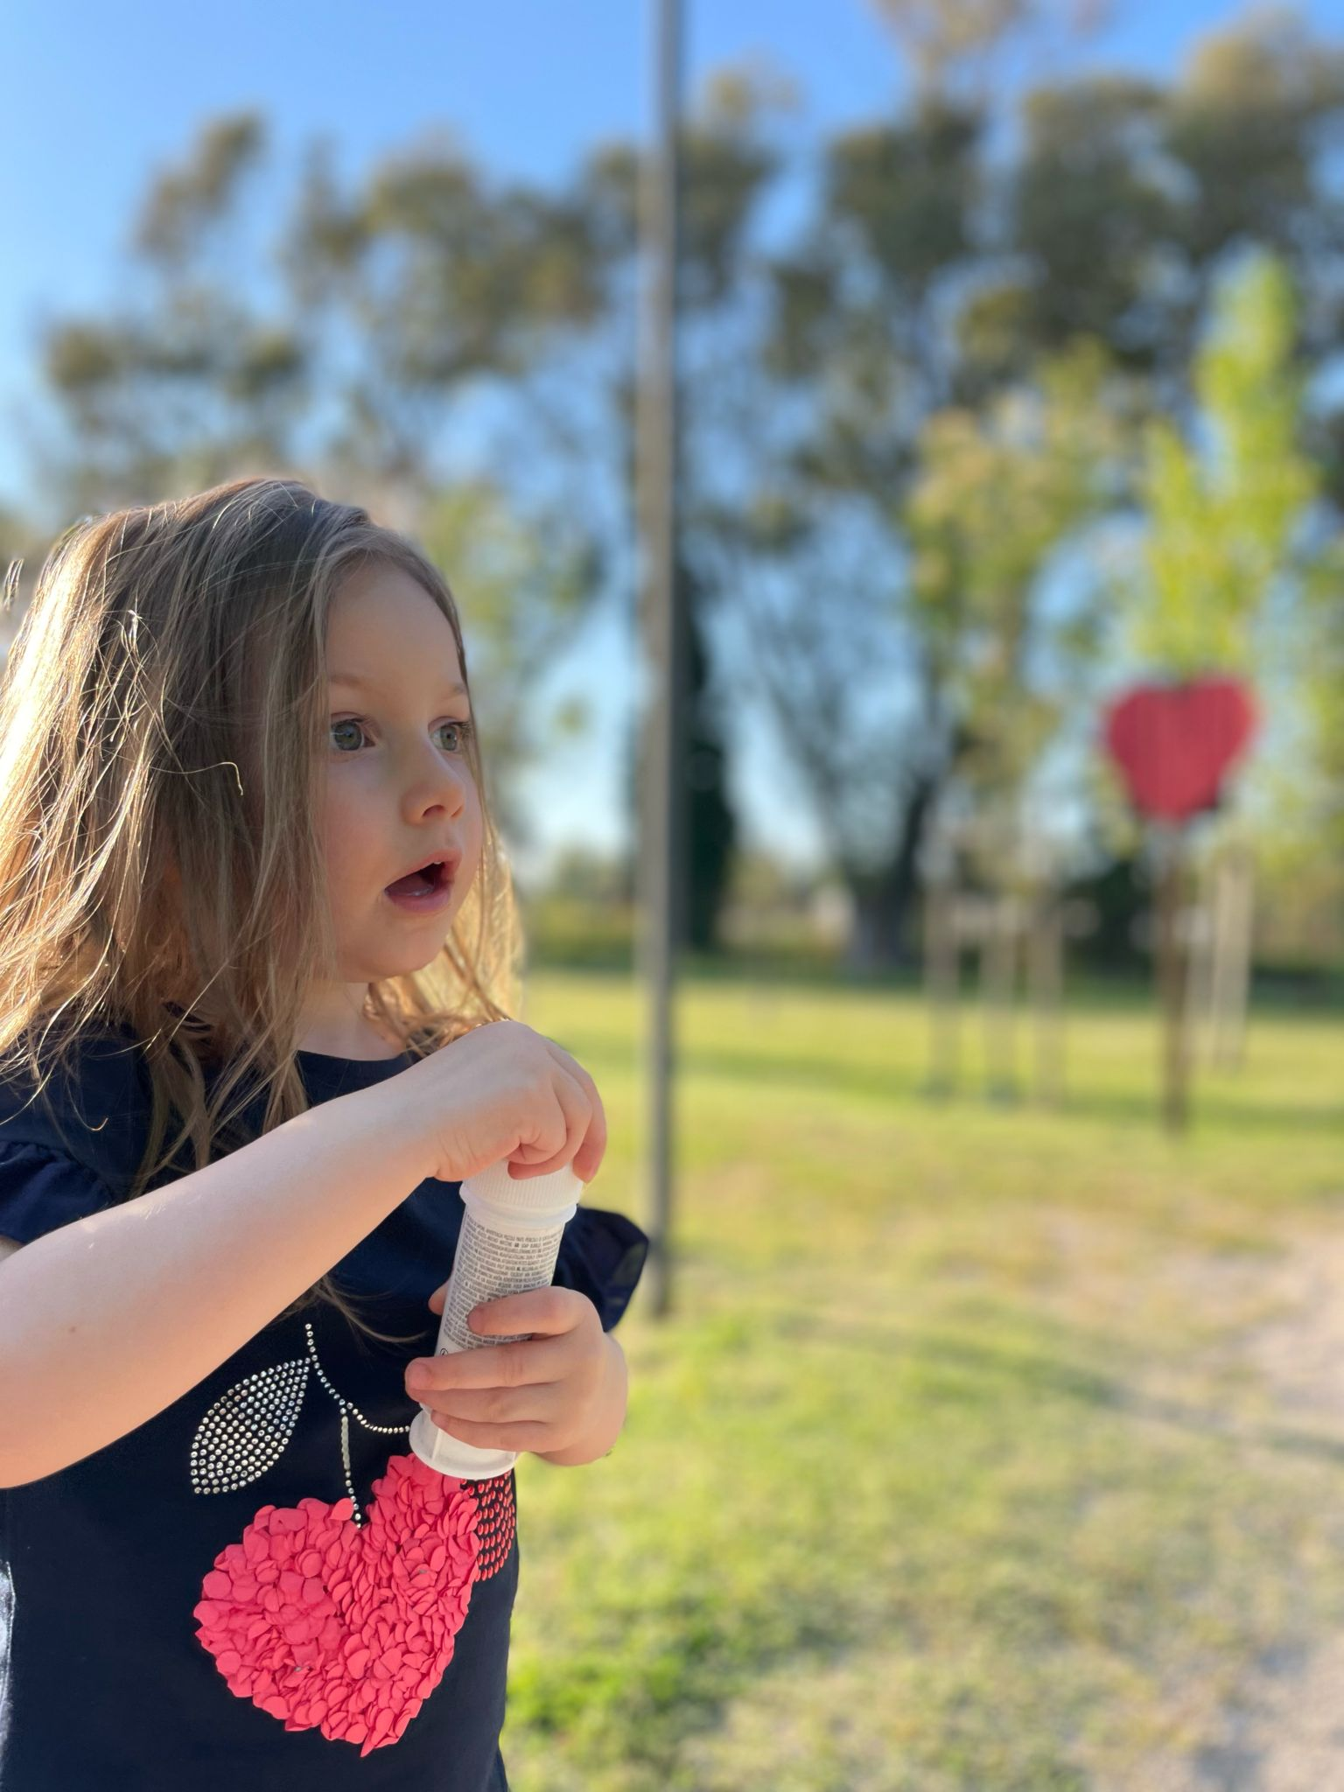

Thanks for your attention
Angelo.iossa@uniroma1.it
@angeloiossmd

